Slide 1
SMS Speak Encoder
7 February 2012
Letitia Etsebeth
15597601

Slide 2
The Process
Step 1 – Change the string to lowercase
Step 2 – Remove all punctuation in the string
Step 3 – Remove all non-boundary vowels
Step 4 – Remove repeating characters
Step 5 – Display the output

Slide 3
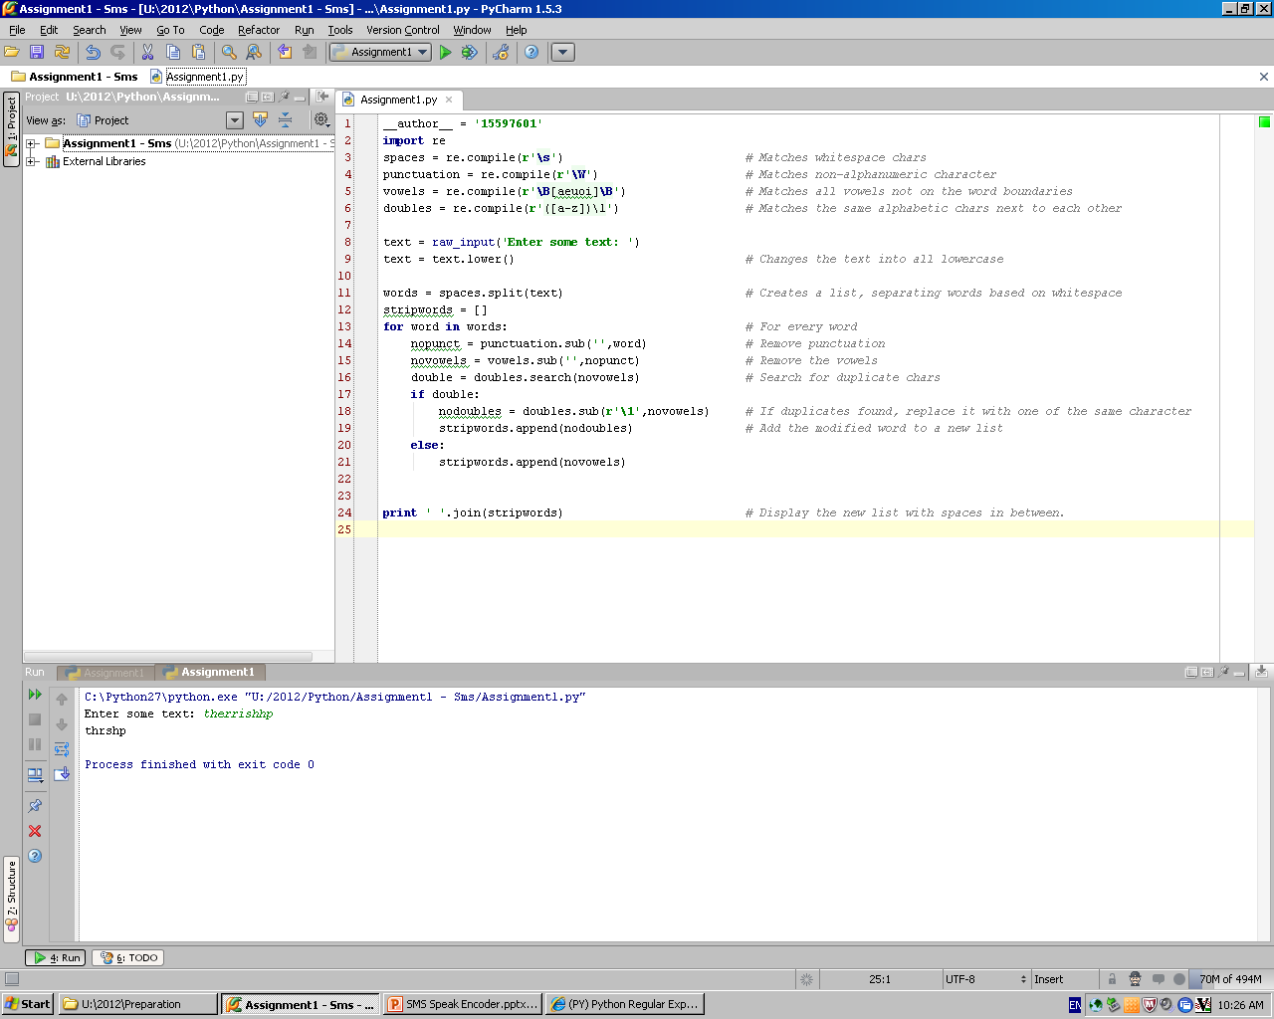
Step 1 - Lowercase
Change the input string to entirely lowercase

Slide 4
Step 2 – Punctuation
Divide the string into words: (Makes handling punctuation easier)
For every word, remove the punctuation:

Slide 5
Step 3 – Vowels
Remove the vowels not on word boundaries:

Slide 6
Step 4 – Repeating Characters
Remove the vowels not on word boundaries:
Search for repeating characters:
If found, replace them with a single identical character:

Slide 7
Step 5 - Display
Append the modified words to a list:
or
Print the list with separating spaces:

Slide 8
Demo

